Slide 1


Chapter 4
Shared Objects & Mutual Exclusion

Slide 2
Shared Objects & Mutual Exclusion
Concepts: process interference (incorrect updates of
the state of a shared object).
mutual exclusion.
Models: model checking for interference
modeling mutual exclusion
Practice: thread interference in shared Java objects
mutual exclusion in Java
(synchronized objects/methods).

Slide 3
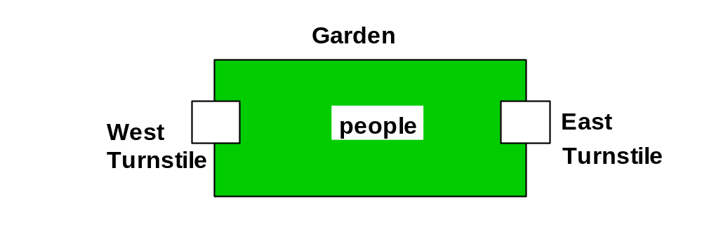
4.1 Interference
Ornamental garden problem:
People enter an ornamental garden through either of two turnstiles. Management wish to know how many are in the garden at any time.
The concurrent program consists of two concurrent threads and a shared counter object.

Slide 4
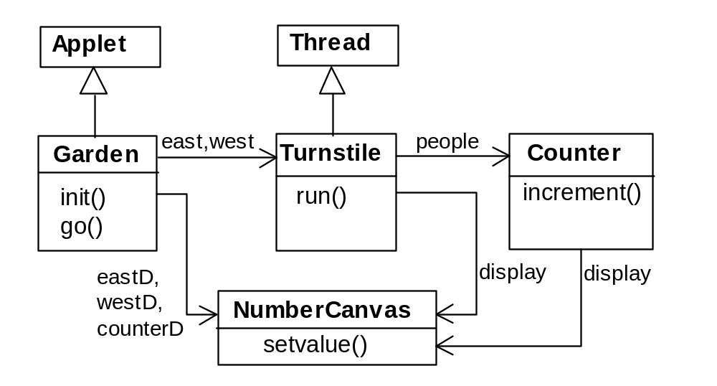
ornamental garden Program - class diagram
The Turnstile thread simulates the periodic arrival of a visitor to the garden every second by sleeping for a second and then invoking the increment() method of the counter object.

Slide 5
ornamental garden program
The Counter object and Turnstile threads are created by the go() method of the Garden applet:
    private void go() {
    counter = new Counter(counterD);
    west = new Turnstile(westD,counter);
    east = new Turnstile(eastD,counter);
    west.start();
    east.start();
    }
Note that counterD, westD and eastD are objects of NumberCanvas used in chapter 2.

Slide 6
Turnstile class
class Turnstile extends Thread {
NumberCanvas display;
Counter people;
Turnstile(NumberCanvas n,Counter c)
{ display = n; people = c; }
public void run() {
try{
display.setvalue(0);
for (int i=1;i<=Garden.MAX;i++){
Thread.sleep(500); //0.5 second between arrivals
display.setvalue(i);
people.increment();
}
} catch (InterruptedException e) {}
}
}
The run() method exits and the thread terminates after Garden.MAX visitors have entered.

Slide 7
Counter class
class Counter {
int value=0;
NumberCanvas display;
Counter(NumberCanvas n) {
display=n;
display.setvalue(value);
}
void increment() {
int temp = value; //read value
Simulate.HWinterrupt();
value=temp+1; //write value
display.setvalue(value);
}
}
Hardware interrupts can occur at arbitrary times.
The counter simulates a hardware interrupt during an increment(), between reading and writing to the shared counter value. Interrupt randomly calls Thread.sleep() to force a thread switch.

Slide 8
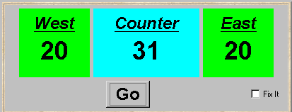
ornamental garden program - display
After the East and West turnstile threads have each incremented its counter 20 times, the garden people counter is not the sum of the counts displayed. Counter increments have been lost. Why?

Slide 9
concurrent method activation
Java method activations are not atomic - thread objects east and west may be executing the code for the increment method at the same time.
west
east
shared code
PC
PC
increment:
read value
write value + 1
program
counter
program
counter

Slide 10
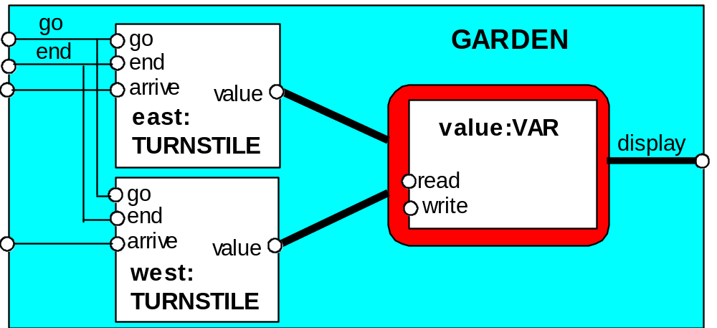
ornamental garden Model
Process VAR models read and write access to the shared counter value.
Increment is modeled inside TURNSTILE since Java method activations are not atomic i.e. thread objects east and west may interleave their read and write actions.

Slide 11
ornamental garden model
const N = 4
range T = 0..N
set VarAlpha = { value.{read[T],write[T]} }
VAR = VAR[0],
VAR[u:T] = (read[u] ->VAR[u]
|write[v:T]->VAR[v]).
TURNSTILE = (go -> RUN),
RUN = (arrive-> INCREMENT
|end -> TURNSTILE),
INCREMENT = (value.read[x:T]
-> value.write[x+1]->RUN
)+VarAlpha.
||GARDEN = (east:TURNSTILE || west:TURNSTILE
|| { east,west,display}::value:VAR)
/{ go /{ east,west} .go,
end/{ east,west} .end} .
The alphabet of shared process VAR is declared explicitly as a set constant, VarAlpha.
The TURNSTILE alphabet is extended with VarAlpha to ensure no unintended free (autonomous) actions in VAR eg. value.write[0]. All actions in the shared VAR must be controlled (shared) by a TURNSTILE.

Slide 12
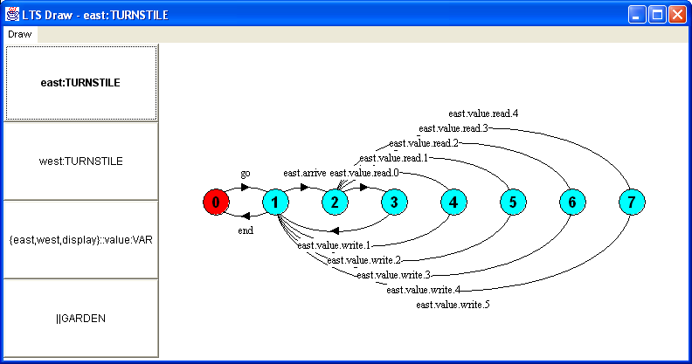
LTS for TURNSTILE

Slide 13
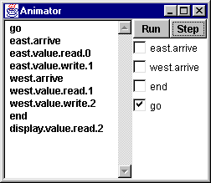
checking for errors - animation
Scenario checking - use animation to produce a trace.
Is this trace correct?

Slide 14
checking for errors - exhaustive analysis
Exhaustive checking - compose the model with a TEST process which sums the arrivals and checks against the display value:
TEST = TEST[0],
TEST[v:T] =
(when (v<N){east.arrive,west.arrive}->TEST[v+1]
|end->CHECK[v]
),
CHECK[v:T] =
(display.value.read[u:T] ->
(when (u==v) right -> TEST[v]
|when (u!=v) wrong -> ERROR
)
)+{display.VarAlpha}.
Like STOP, ERROR is a predefined FSP local process (state), numbered -1 in the equivalent LTS.

Slide 15
ornamental garden model - checking for errors
||TESTGARDEN = (GARDEN || TEST).
Use LTSA to perform an exhaustive search for ERROR.
    Trace to property violation in TEST:
    go
    east.arrive
    east.value.read.0
    west.arrive
    west.value.read.0
    east.value.write.1
    west.value.write.1
    end
    display.value.read.1
wrong
LTSA produces the shortest path to reach ERROR.

Slide 16
Interference and Mutual Exclusion
  Destructive update, caused by the arbitrary interleaving of read and write actions, is termed interference.
Interference bugs are extremely difficult to locate. The general solution is to give methods mutually exclusive access to shared objects. Mutual exclusion can be modeled as atomic actions.

Slide 17
4.2 Mutual exclusion in Java
  Concurrent activations of a method in Java can be made mutually exclusive by prefixing the method with the keyword synchronized, which uses a lock on the object.
We correct COUNTER class by deriving a class from it and making the increment method synchronized:
class SynchronizedCounter extends Counter {
SynchronizedCounter(NumberCanvas n)
{super(n);}
synchronized void increment() {
super.increment();
}
}
acquire lock
release lock

Slide 18
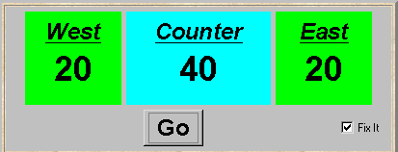
mutual exclusion - the ornamental garden
Java associates a lock with every object. The Java compiler inserts code to acquire the lock before executing the body of the synchronized method and code to release the lock before the method returns. Concurrent threads are blocked until the lock is released.

Slide 19
Java synchronized statement
Access to an object may also be made mutually exclusive by using the synchronized statement:
synchronized (object) { statements }
A less elegant way to correct the example would be to modify the Turnstile.run() method:
synchronized(people) {people.increment();}
Why is this “less elegant”?
To ensure mutually exclusive access to an object, all object methods should be synchronized.

Slide 20
4.3 Modeling mutual exclusion
To add locking to our model, define a LOCK, compose it with the shared VAR in the garden, and modify the alphabet set :
LOCK = (acquire->release->LOCK).
||LOCKVAR = (LOCK || VAR).
set VarAlpha = {value.{read[T],write[T],
acquire, release}}
Modify TURNSTILE to acquire and release the lock:
TURNSTILE = (go -> RUN),
RUN = (arrive-> INCREMENT
|end -> TURNSTILE),
INCREMENT = (value.acquire
-> value.read[x:T]->value.write[x+1]
-> value.release->RUN
)+VarAlpha.

Slide 21
Revised ornamental garden model - checking for errors
A sample animation execution trace
    go
    east.arrive
    east.value.acquire
    east.value.read.0
    east.value.write.1
    east.value.release
    west.arrive
    west.value.acquire
    west.value.read.1
    west.value.write.2
    west.value.release
    end
    display.value.read.2
    right
Use TEST and LTSA to perform an exhaustive check.
Is TEST satisfied?

Slide 22
COUNTER: Abstraction using action hiding
To model shared objects directly in terms of their synchronized methods, we can abstract the details by hiding.
For SynchronizedCounter we hide read, write, acquire, release actions.
const N = 4
range T = 0..N
VAR = VAR[0],
VAR[u:T] = ( read[u]->VAR[u]
| write[v:T]->VAR[v]).
LOCK = (acquire->release->LOCK).
INCREMENT = (acquire->read[x:T]
-> (when (x<N) write[x+1]
->release->increment->INCREMENT
)
)+{read[T],write[T]}.
||COUNTER = (INCREMENT||LOCK||VAR)@{increment}.

Slide 23
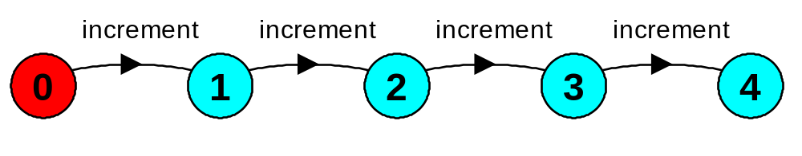
COUNTER: Abstraction using action hiding
Minimized LTS:
We can give a more abstract, simpler description of a COUNTER which generates the same LTS:
COUNTER = COUNTER[0]
COUNTER[v:T] = (when (v<N) increment -> COUNTER[v+1]).
This therefore exhibits “equivalent” behavior i.e. has the same observable behavior.

Slide 24
Summary
Concepts
  process interference
  mutual exclusion
Models
  model checking for interference
  modeling mutual exclusion
Practice
  thread interference in shared Java objects
  mutual exclusion in Java (synchronized objects/methods).

